Slide 1

Presented By : Sri Harshith
Seminar On Water Pollution
PPT By : Siddharth
Eswar
Jayanth Puneeth

Slide 2
Why Do We Need To Know About Water Pollution?
Water is essential for life. Without water, there would be no life in existence.
We usually take water for granted for its purity, but we need to ensure its quality.
Water pollution originates from human activities.
Water pollution reaches groundwater water by seeping underground.

Slide 3
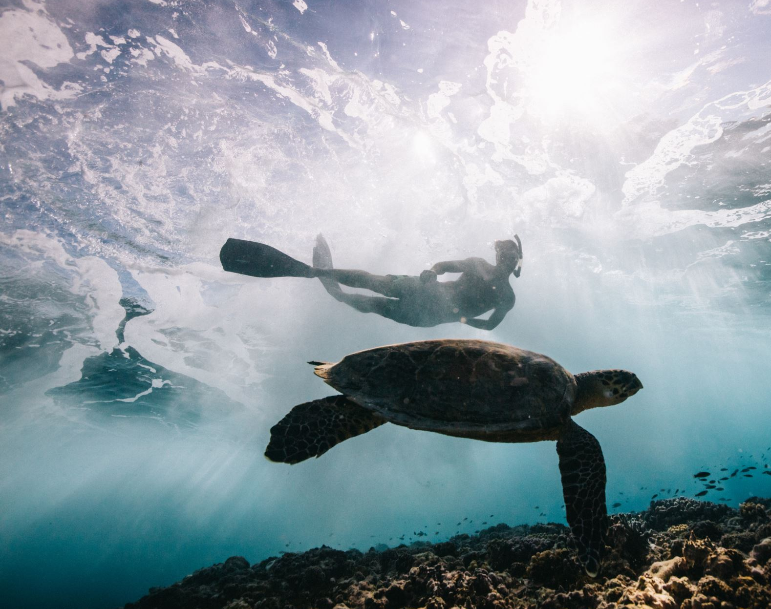
What Is Water Pollution?
Water pollution (or aquatic pollution) is the contamination of water bodies, usually as a result of human activities.
Water pollution results when contaminants are introduced into the natural environment. For example, releasing inadequately treated wastewater into natural water bodies can lead to degradation of aquatic ecosystems.

Slide 4
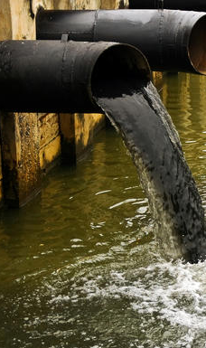
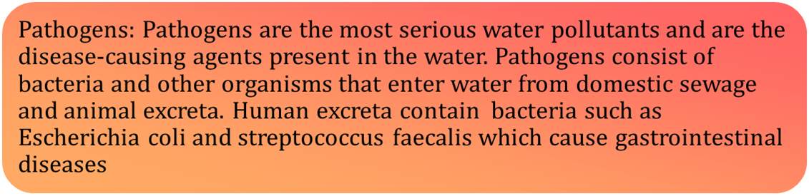
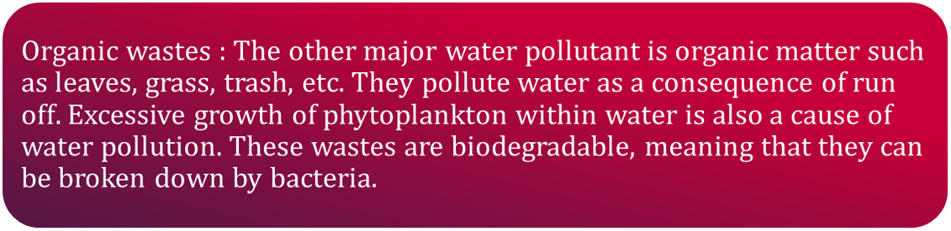
Causes Of Water Pollution

Slide 5
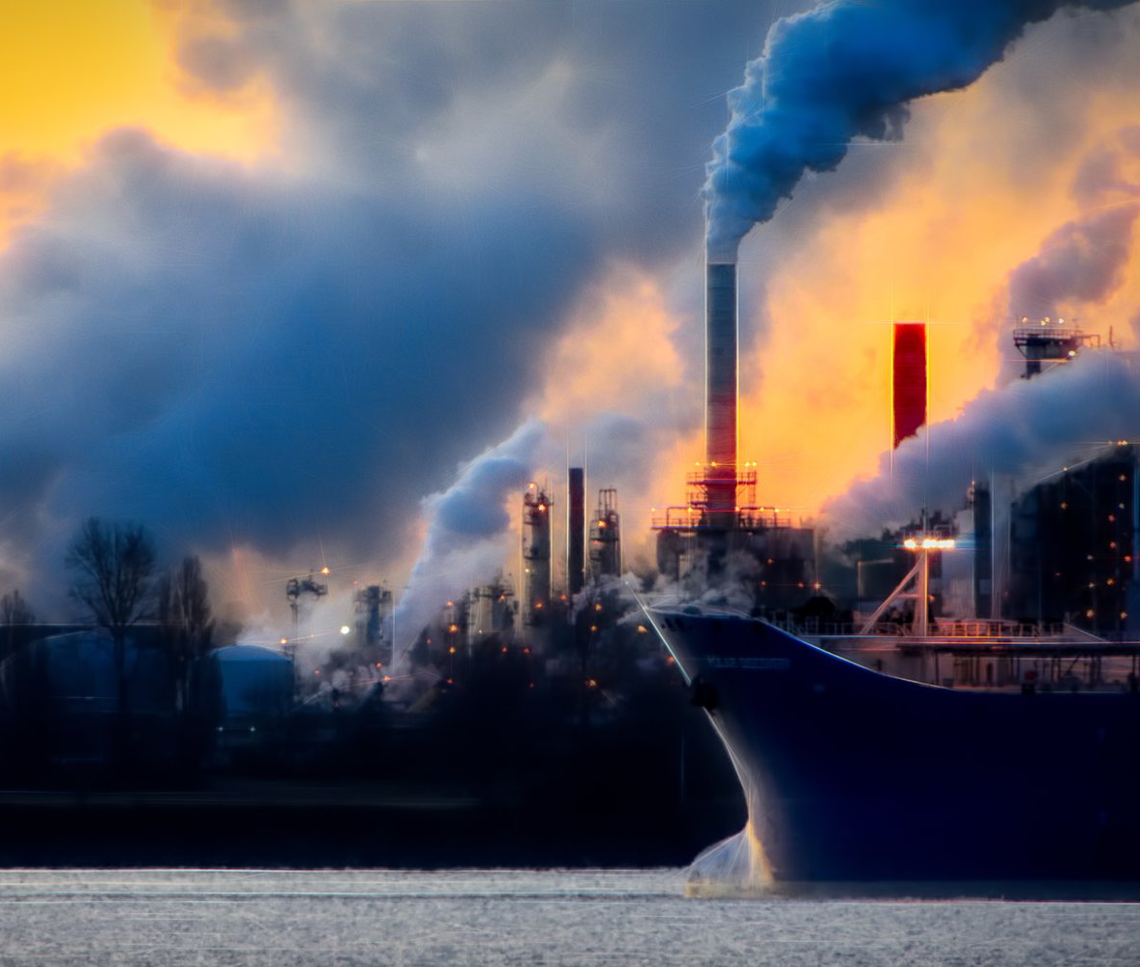
Chemical Pollutants
Chemical Pollutants : Water is an excellent solvent, water soluble inorganic chemicals that include heavy metals such as mercury, cadmium, nickel ,etc. constitute an important class of pollutants. All these materials are harmful to humans because we can't excrete them, and they can damage human organs if the amount passes a certain tolerance limit.

Slide 6
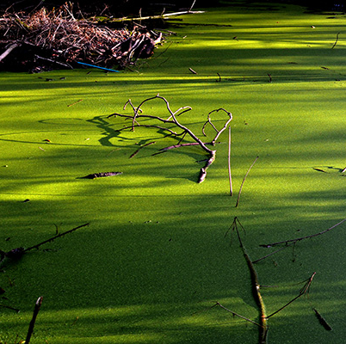
Eutrophication
Eutrophication is the process in which nutrient enriched water bodies support a dense plant population which kills animal life by depriving it of oxygen and results in the subsequent loss of biodiversity

Slide 7
Effects Of Water Pollution
Deteriorating water quality : It is damaging the environment, health conditions and the global economy. The president of the World Bank, David Malpass, warns of the economic impact: "Deteriorating water quality is stalling economic growth and exacerbating poverty in many countries".
Diseases : Not just the aquatic life, even when the humans end up drinking polluted water, they make themselves vulnerable to various life-threatening illnesses like hepatitis, cholera, typhoid, and many other water-borne diseases.
Ruination of the ecosystem : Our ecosystem is extremely fragile. Even a simple change can lead the ecosystem to react and impact the environment. If the water system is unchecked in a particular locality, then the whole ecosystem of that area may collapse.

Slide 8
Methods to Reduce Water Pollution
Using Phosphate-Free Detergent and Dish Cleaner : Phosphates aren’t the only harmful chemicals in cleaners, they lead to algae blooms and kill fish and other aquatic organisms by reducing oxygen present in water.
Disposing Medical Waste Properly : Never flush medicines down the toilet, and never dump them in the nearest pond or creek. The drugs tend to accumulate in the water, and in fish and other wildlife.
Try to Avoid Plastic Containers : Plastic shopping bags and plastic rings from six-packs of beverages cause inordinate problems in the nation's lakes and seas. Plastic bottles can last for decades in the water.

Slide 9
International Standards for Drinking Water
The International Standards for drinking water
Element / Compound | Maximum Concentration (ppm or mg dm-3) | Element / Compound | Maximum Concentration (ppm or mg dm⁻³)
Fe | 0.2 | Fluoride (F⁻⁾ | 2ppm
Mn | 0.05 | Lead | 50 (ppb)
Al | 0.2 | Sulphate | 500
Cu | 3.0 | Nitrate | 50
Zn | 5.0 | Cd | 0.005
Drinking water must contain elements/ ions/ chemical compounds in required concentrations to maintain health.
ppm = parts per million
ppb = parts per billion

Slide 10
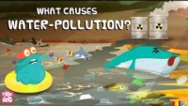
Hey guys, here is a video to help you understand better!

Slide 11


Thank You!

